Slide 1
Aging Dentate Gyrus Neurogenesis for Circuit Optimization
With Math and Nanoparticles

Slide 2
Principles of Neural Information Theory
Icebreaker: What did we learn from the forbidden reading?
One step further… Source Coding Theorem in a (theoretically) noiseless channel:
Page 18,
Notes:
Plz bwing z bookz

Slide 3
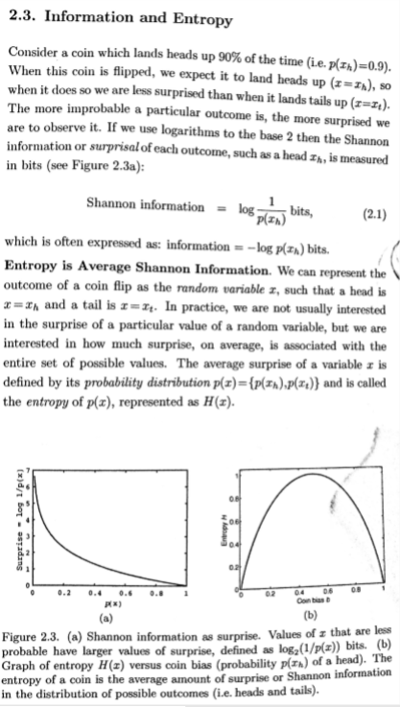
NOT ON THE TEST

Slide 4
What is Information? Who cares?
How is it quantified? -Is this a reasonable abstraction?
Why is it relevant to biological systems, particularly the nervous system?
How do we (justifiably) translate an abstract binary value through an imaginary, yet formal, organization of variables and basic operations to achieve a biologically-plausible, informationally predictable, and behaviorally meaningful model of organismal function?
What is the fundamental computational process that allowed homo sapiens to get to where they are now?

Slide 5
Game: an introduction to data perchloration
Local Codes:
Dense, Distributed Codes:
Notes:
At one extreme of low average activity fraction are local codes, in which each item is represented by a separate neuron or a small set of neurons. This way there is no overlap between the representations of any two items in the sense that no neuron takes part in the representation of more than one item. An analogy might be the coding of characters on a computer keyboard (without the Shift and Control keys), where each key encodes a single character. Note that locality of coding does not necessarily imply that only one neuron encodes an item, it only says that the neurons are highly selective, corresponding to single significant items of the environment (e.g. grandmother cell).
This scheme has the advantage that it is simple and is also easy to decode. In a neural network, it is possible to make associations between a locally encoded item and any output by Hebbian strengthening of the synaptic connections between their neural representations in a single trial.
Local coding avoids the risk of unwanted interference between separately stored memories. It is also often possible to represent multiple locally coded items simply by the combined activity of the corresponding neurons without ambiguity.
However, there are many disadvantages to local coding: its representational capacity (here and in the following: the number of distinct representable information items) is low; that is, N binary neural units can only represent a maximum of N different items. This is a very small number compared to the number of stimuli we need to be able to discriminate even if N is comparable to the number (billions) of neurons in the human brain. Representational capacity also limits memory capacity, as no different outputs can be assigned to states that are indistinguishable. Another drawback of binary local coding is that as each representation is totally distinct from all others, associations linked to one item do not generalize to any other items that can be distinguished from it, even when this would be beneficial. Generalization is an essential and widely observed behavior (e.g., McLaren and MacKintosh (2002)); if we have good discrimination, we are unlikely to ever encounter situations that are indistinguishable from each other. Therefore we need to apply our experiences from different situations having relevant aspects.
The lack of interaction between locally encoded items may be both an advantage, when it avoids unwanted interference, and a disadvantage, when such interactions are necessary for useful generalization.
The other extreme (average activity ratio ≈0.5) corresponds to dense, or holographic coding. Here, an information item is represented by the combination of activities of all neurons. For N binary neurons, that implies a representational capacity of 2^N. Given the billions of neurons in a human brain, 2^N is beyond astronomical. As the number of neurons in the brain (or even just in a single cortical area, such as primary visual cortex) is substantially higher than the number of receptor cells (e.g. in the retina), the representational capacity of a dense code in the brain is much greater than what we can experience in a lifetime (the factor of the number of moments in a lifetime adds the requirement of only about 40 extra neurons). Therefore the greatest part of this capacity is redundant.
Decoding a dense representation can be difficult as the whole neural population must be taken into account. For populations larger than a few thousand neurons, this goes beyond the capabilities of single neurons and may require a multilayer network. Dense encoding also implies that only one pattern can be represented at a given time. Superimposing more than one pattern makes the code hard to decode and may even introduce ambiguities (see Binding Problem) and interference. Dense codes also limit the number of memories that can be stored in an associative memory by simple, local learning rules (e.g. Hebbian learning). The mapping between such a pattern and an output is usually complex (not linearly separable) and cannot be learned easily and quickly by biologically plausible mechanisms. On the plus side, dense codes may facilitate good generalization performance and the high redundancy may lead to high fault tolerance to the failures of some of the units or connections.

Slide 6
Compare, Contrast, then Optimize
Local:
Pros:
-
Cons:
-
Dense, Distributed:
Pros:
-
Cons:

Slide 7
Hypothesis: Biology beats the technical issues of both local and dense, distributed coding by...
If:
___
Then
___
:
Features:

Slide 8
Sparse Coding(small avg activity ratio)
http://www.scholarpedia.org/article/Sparse_coding
Efficiencies and Resolutions:
___
Issues:
___
Notes:
Sparse codes (small average activity ratio) are a favourable compromise between dense and local codes (Földiák 2002). The small representational capacity of local codes can be remedied with a modest fraction of active units per pattern because representational capacity grows exponentially with average activity ratio (for small average activity ratios). Thus, distinct items are much less likely to interfere when represented simultaneously. Furthermore, it is much more likely that a single layer network can learn to generate a target output if the input has a sparse representation (Willshaw and Dayan 1990). This is due to the higher proportion of mappings being implementable by a linear discriminant functions (linear separability, see Perceptron). Learning in single layer networks is therefore simpler, faster and substantially more plausible in terms of biological implementation. By controlling sparseness, the amount of redundancy necessary for fault tolerance can be chosen. With the right choice of code, a relatively small amount of redundancy can lead to highly fault-tolerant decoding. For instance, the failure of a small number of units may not make the representation undecodable. Moreover, a sparse distributed code can represent values at higher accuracy than a local code. Such distributed coding is often referred to as coarse coding.
A code with a given average sparseness can contain codewords of varying sparseness. If the goal is to maximize sparseness while keeping representational capacity high, a sensible strategy is to assign sparse codewords to high probability items and more distributed codewords to lower probability items. This implements codes with with low energy expenditure, since neural activity consumes energy. Alternatively, if one only stored the identities of the active units, the resulting code would have a short average description length (Cover and Thomas 2006). Several aspects of perceptual learning could be explained by the predicted increase of sparseness of the encoding of items with increased probability.

Slide 9
Sparsely encoded Biology! C= ½(log(1+S/N)) bits
From Scholarpedia, Peter Foldiak…
-single cell narrow tuning specificity, where’s grandma!
-topies indicate sparse coding
-- “higher level” processing could be using increasingly sparse representations (codewords) for high probability code
ENERGY! total APs= 1/sparseness
From Ch4, Pricing Neural Information, Principles of Neural Information Theory…
‘Laws’ of information science govern biological communication as well.
Neural systems evolve attractors toward these theoretical optimizations in concert with principles of metabolic efficiency
Suggesting (metabolic > information) roles
-optimal retinal conductance
- axonal diameter distribution:
girth=> high Signal/Noise
Notes:
One of the striking facts about single-cell physiological recording from sensory cortical areas is the difficulty of finding stimuli that effectively activate the neurons. This is true even at lower levels of sensory processing, such as in primary visual cortex, where the underlying stimulus parameters determining neural selectivity are often assumed to be known. This problem becomes much more severe in higher sensory areas, where the neural selectivity is more complex, and where even the relevant parameters are hard to define. These difficulties reflect the narrow tuning of cortical neurons which, when viewed on the population level, suggest a general sparse coding strategy. The selectivities determined experimentally also seem to match the probabilistically salient features of natural stimulation. This is what would be expected if the neural code conformed to information theoretic principles (Cover and Thomas 2006).
Field (1987, 1994) applied this idea to simple cells in primary visual cortex suggesting that basis functions limited both in space and frequency domains (such as Gabor functions) maximize sparseness when applied to natural images. Olshausen and Field (2004) give examples of sparse coding in other brain regions.
Neurons with complex selectivities in higher-level visual cortex (e.g. neurons selective to faces), could be interpreted as forming sparser codewords predicted for high probability items (e.g. faces) by the minimum description length principle.
Sparse coding is also relevant to the amount of energy the brain needs to use to sustain its function. The total number of action potentials generated in a brain area is inversely related to the sparseness of the code, therefore the total energy consumption decreases with increasing sparseness. Neural activity distributions observed experimentally can be approximated by exponential distributions, which has the property of maximizing information transmission for a given mean level of activity (bits/spike) (Baddeley et al. 1998).

Slide 10
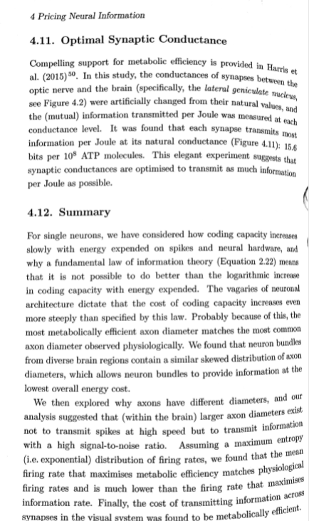

Slide 11
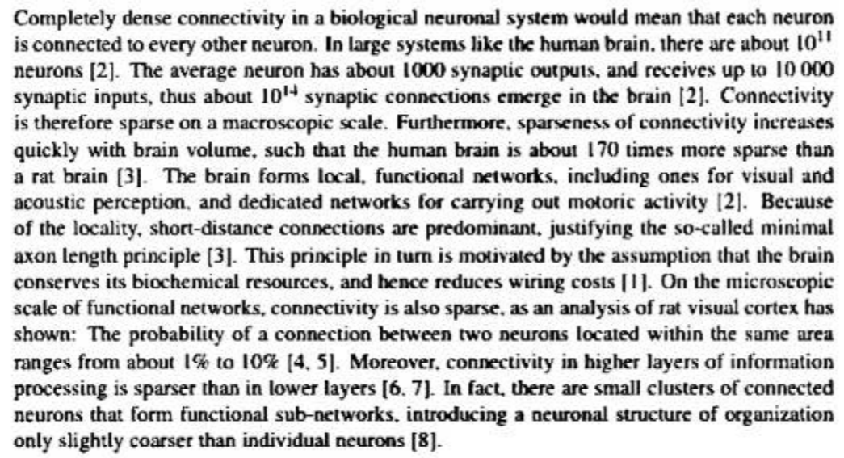

Slide 13
Tutorial on Neural Systems Modeling
Mathboxs 1.1, 1.2, 4.2, 4.3, then onto papers!
Why we model:
(omega) hubris
(alpha) fix things
Q: Who should quant?
A: Each entity trying to do either alpha, omega, or both

Slide 14
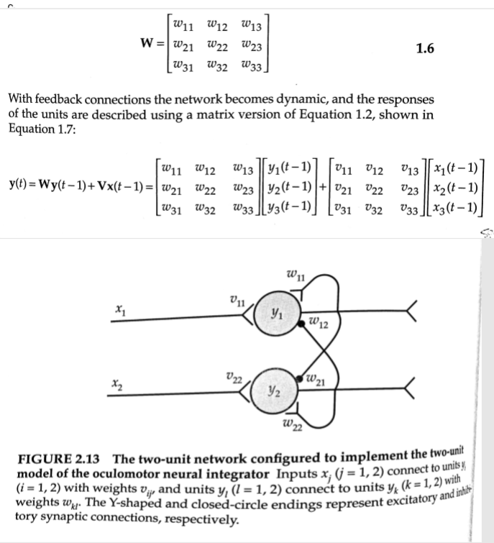
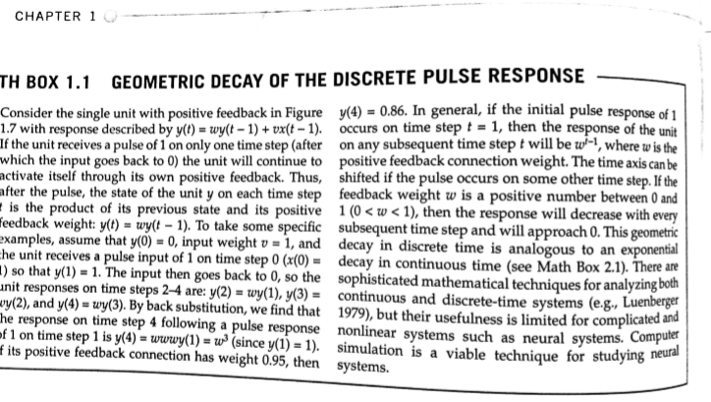
The basic organization and computational reasons for decay

Slide 15
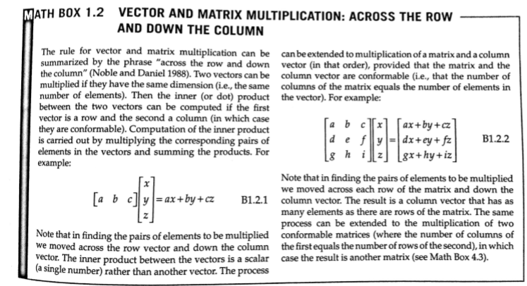
A review of the process...

Slide 16
Now with two vectors => matrix

Slide 17
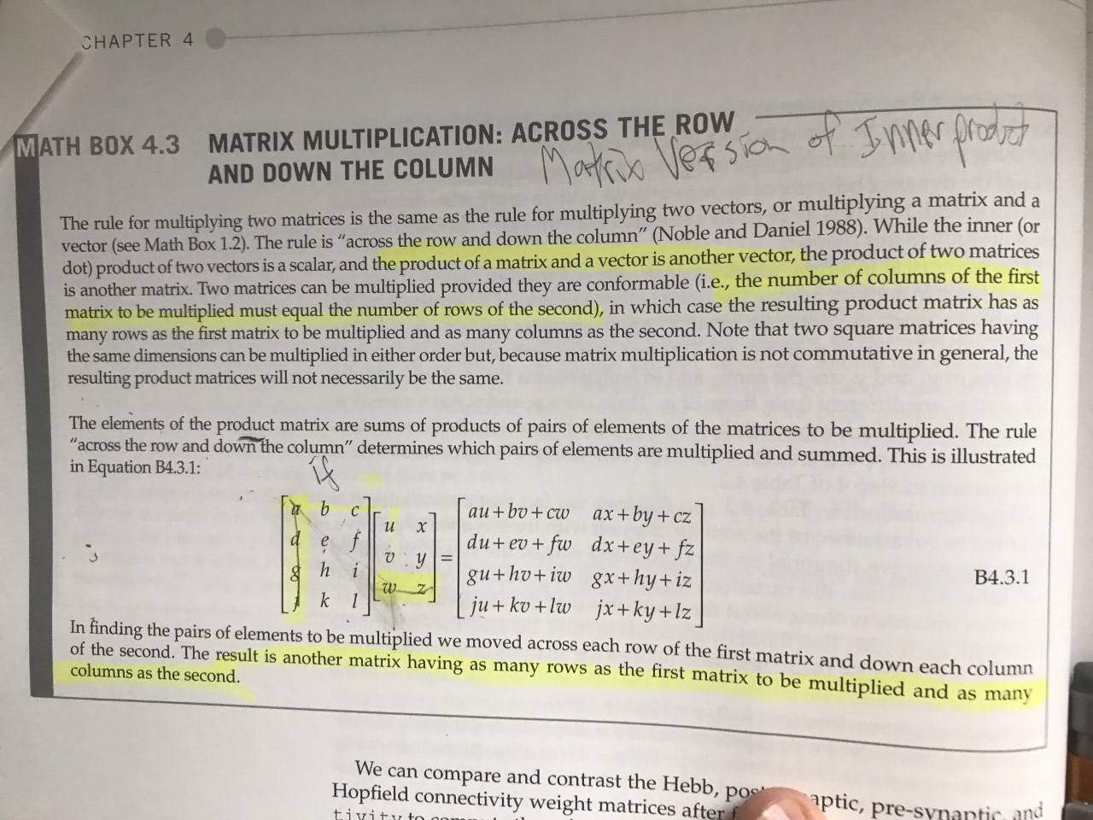
Two matrices=> another matrix
Notes:
Constraints with math modeling, hurdles

Slide 18
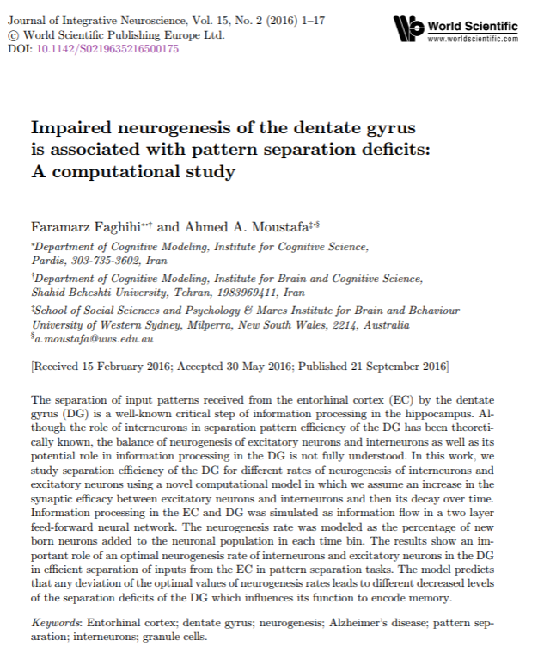
Impaired neurogenesis of the dentate gyrus is associated with pattern separation deficits: A computational study

Slide 19
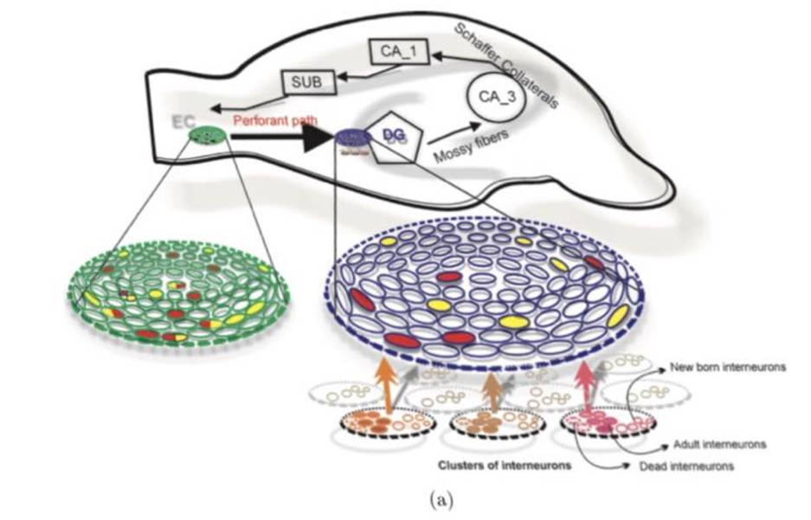
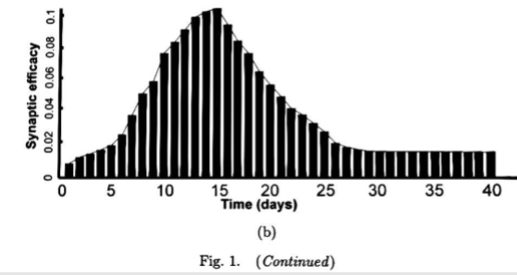
Fig. 1:(a) Context, and (b) SE decay curve
Notes:
Fig. 1. (Color online) Model architecture. (a) Information is transferred from the EC into the DG, and then to other parts of the hippocampus. Information °ow from the EC to the DG is modeled as a two layer feed-forward neural network composed of 500 neurons in the EC and 2500 neurons in the DG. Neurons in the EC are connected to neurons in the DG according to probability between 0.1 and 0.4. The number of neurons of the EC and the DG are dynamically determined by birth and death rates. The number of interneurons organized as clusters in the DG is changed over time according to death and birth rate too. The DG separates input patterns in the EC in intact hippocampus such that overlapped patterns in the EC (neurons in the EC activated by both stimulus shown as red-yellow neurons) are presented as fully or well-separated sets of neurons (shown as red and yellow neurons in the DG). (b) Change of the synaptic e±cacy between the interneurons and excitatory neurons in the DG over time. In this modeling framework, it is assumed that synaptic e±cacy between interneurons and DG excitatory neurons is changed over time such that it is increased gradually after birth and gets its maximum value after 15 days then it is decreased gradually to a low level.

Slide 20
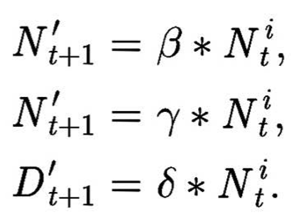
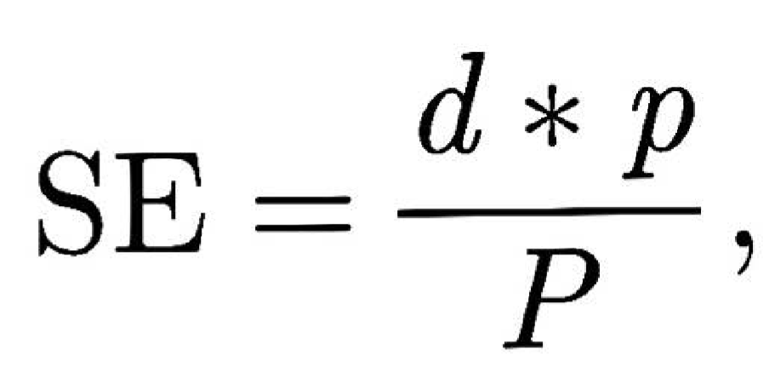
The governing equations, perhaps with demo
Update Synchrony:
Evaluation Measure:
For more, start with Leaky Integrate-and-Fire Model https://www.youtube.com/watch?v=gU9UzFeg8f4 , from Neural Dynamics book and MOOC https://neuronaldynamics.epfl.ch/index.html

Slide 21
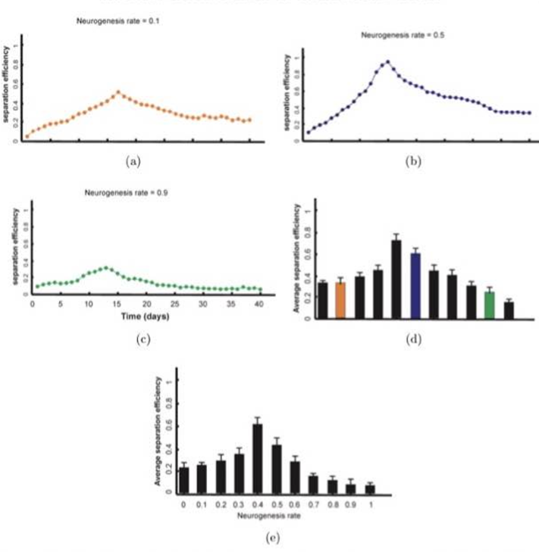
Fig. 2 Separation Efficiency over diff. neurogenesis rates
No excitatory neurogenesis, just interneurons
Max avg SE @ 0.4 neurogenesis rate
Marked decrease in SE esp above 0.6
Notes:
SE of the DG over time for di®erent neurogenesis rates of interneurons. The SE of the DG was measured for di®erent neurogenesis rates as a function of time of interneurons in the absence of neurogenesis in excitatory neurons. (a) For a low neurogenesis rate equal to 0.1, maximum e±ciency was obtained after 17 days. The e±ciency is decreased gradually and gets low levels of e±ciency. (b) For a neurogenesis rate equal to 0.5 the maximum e±ciency was obtained after 15 days and then simulations show a low e®ect on the SE. (c) For a high neurogenesis rate the maximum SE was obtained after 13 days but it was lower than SE for a neurogenesis rate equal to 0.1. (d) Average SE of the DG for similar input patterns over time for di®erent neurogenesis rates. Average SE of the DG over 40 days for di®erent interneurons' neurogenesis rate was measured by presenting input patterns to the EC with 80% similarity. Maximum average e±ciency was obtained at neurogenesis rate equal to 0.4. For higher rates it is decreased to lower levels. (e) Average SE of the DG for input patterns with di®erent intensities for di®erent neurogenesis rates. Maximum average SE was obtained at a neurogenesis rate equal to 0.4. Increase in neurogenesis rate leads to remarkable decrease in the e±ciency especially for rates higher than the 0.6

Slide 22
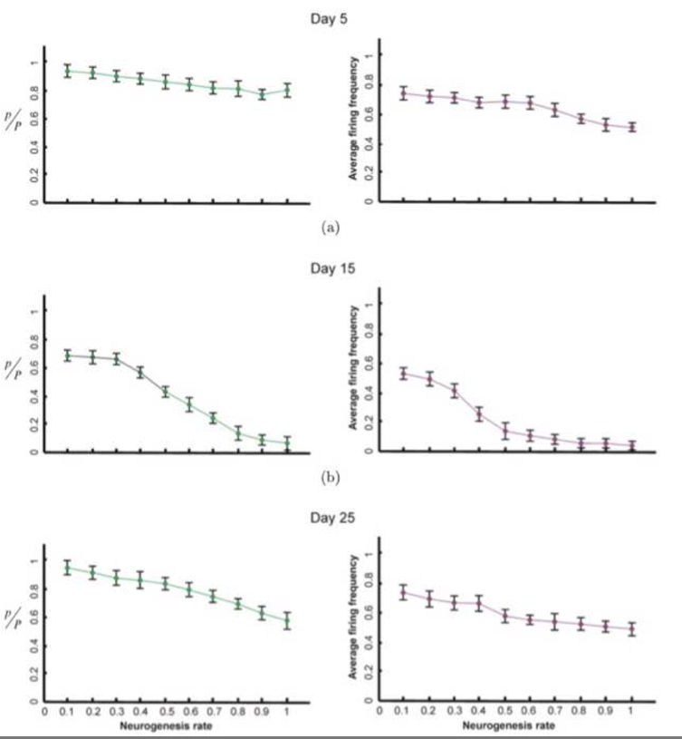
Fig 3: Interneuron neurogenesis on DG activity w/ diff input intensities across neuron lifespan
Interneuron -genesis ^I(t)inhibitory, drop activity
Max effect for middle aged, low info output
Notes:
The e®ect of interneurons' neurogenesis rate on the DG neurons activity for inputs with di®erent intensities for early stage (a), Middle stage (b) and late stage (c) of interneurons' lifetime in the simulations. Left panels: The percentage of activated neurons in the DG for di®erent neurogenesis rates when low intensity inputs were presented to the EC. Compared to zero neurogenesis rate, an increase in neurogenesis rate causes an increase in inhibitory current into the DG neurons, which in turn leads to a decrease in activated neurons in the EC. The maximum e®ect is observed for middle stage of interneurons' time in the simulations (b). Right panels: Average ¯ring frequency of the DG neurons for di®erent neurogenesis rates. An increase in the neurogenesis rate results in a decrease in the ¯ring rate of the DG neurons especially in middle stage of interneurons' lifetime in the simulations (b). This decrease in the ¯ring rate leads to low information transfer to other parts of the hippocampus.

Slide 23
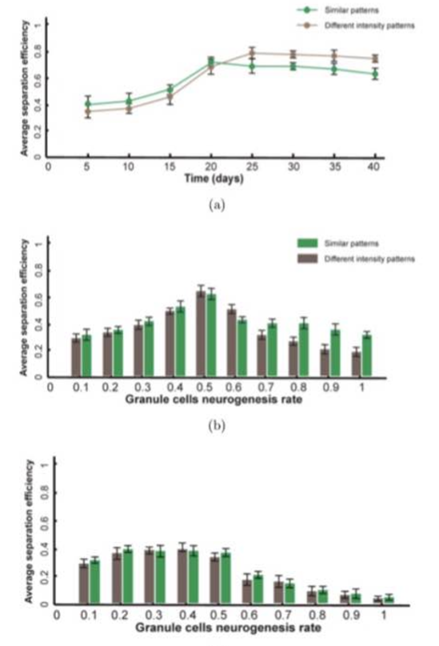
Fig4: SE w/ & w/o exc. & inh. neurogenesis
w/o inhibitory neurogenesis, SE drops
Notes:
Average SE of the DG with and without the combination of excitatory and inhibitory neurons neurogenesis. (a) Average SE of the DG for di®erent pattern separation tasks for excitatory neurons' neurogenesis rate equal to 0.5 and interneurons' neurogenesis rate equal to 0.4. (b) Average SE for di®erent excitatory neurons' neurogenesis rate with combination with inhibitory neurogenesis rate equal to 0.4 leads to a maximum e±ciency at 0.5 for both kinds of separation tasks. (c) Average SE for di®erent granule cell neurogenesis rate in the absence of inhibitory neurogenesis. These simulations demonstrate the critical role of balanced neurogenesis of interneurons and excitatory neuron rates.

Slide 24
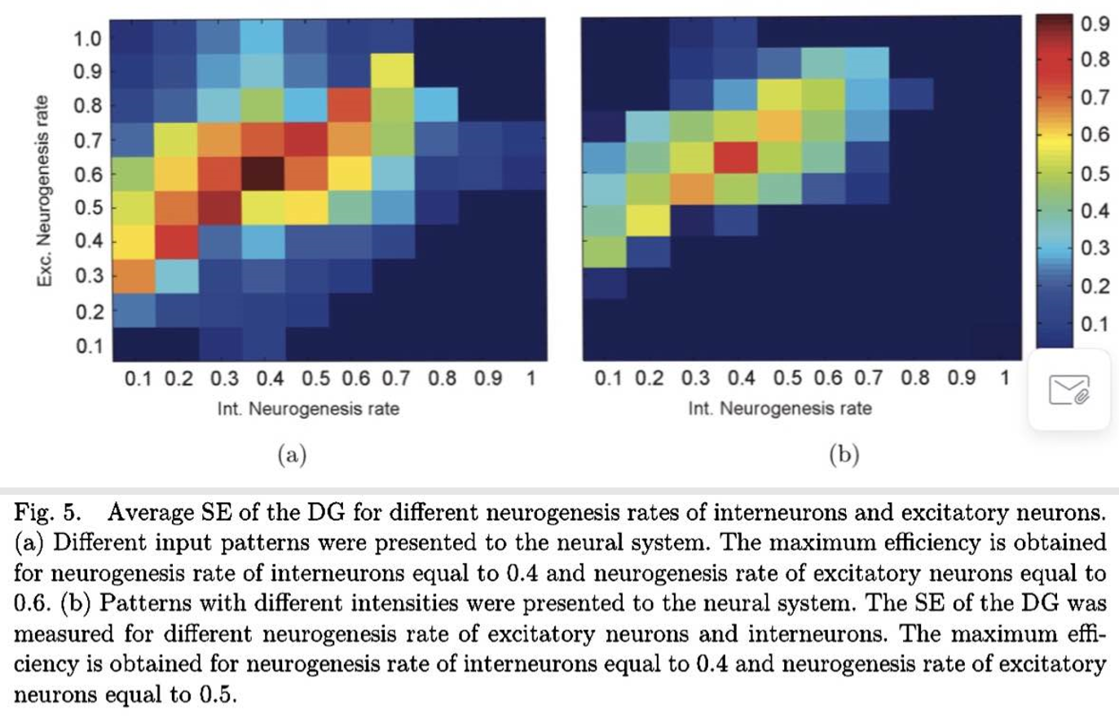
Fig5: Surface of Optimized SE for Exc. vs Inh. neurogenesis rates
Dif inputs: Max @ neurogenesis = 0.6 exc., 0.4 inh.
Dif intensities: Max @ neurogenesis= 0.5 exc., 0.4 inh.

Slide 25
Background Paper A: Conclusions
Providing a physical quantification of information permits optimization analysis
Models help us formulate formal hypothesizes that words alone fail to define
Exc. and inh. Neurogenesis must be balanced for proper separation efficiency in the sparse environment established with this computational model representing DG circuitry

Slide 26
Targeting Adult Neurogenesis to Optimize Hippocampal Circuits in Aging by Kathleen M. McAvoy & Amar Sahay
Millions of individuals suffer from age-related cognitive decline, defined by impaired memory precision. Increased understanding of hippocampal circuit mechanisms underlying memory formation suggests a role for computational processes such as pattern separation and pattern completion in memory precision. We describe evidence implicating the dentate gyrus-CA3 circuit in pattern separation and completion, and examine alterations in dentate gyrus-CA3 circuit structure and function with aging. We discuss the role of adult hippocampal neurogenesis in memory precision in adulthood and aging, as well as the circuit mechanisms underlying the integration and encoding functions of adult-born dentate granule cells. We posit that understanding these circuit mechanisms will permit generation of circuit-based endophenotypes that will edify new therapeutic strategies to optimize hippocampal encoding during aging.
Notes:
Transition to biological realm… what do these normalized values look like in vivo, what’s the phenotypic changes?

Slide 27
Outline of Background Paper B, sections
Introduction
Memory Precision is Impaired With Aging
The DG–CA3 Circuit Supports Pattern Separation and Pattern Completion in Rodents and Humans
Age-Related Changes in DG–CA3 Functions in Rodents
Age-Related Changes in DG–CA3 Functions in Humans
Age-Related Changes in DG–CA3 Structure and Connectivity
Neurogenesis Decreases With Aging and Adult-Born DGCs Contribute to Pattern Separation
Circuit Mechanisms Underlying the Functions of Adult-Born DGCs in Memory Encoding
Adult-Born DGCs Exert Feedback Inhibition Onto the DG to Promote Sparseness
Adult-Born DGCs May Modulate Feed-Forward Inhibition in DG–CA3 Circuit
Targeting Adult Neurogenesis to Improve DG–CA3 Functions in Aging
Promoting Integration of Adult-Born DGCs Into the Hippocampal Circuit
Removing the Brakes on Neural Stem Cell Activation
Towards Healthy Cognitive Aging in the Future

Slide 28
Introduction
Aging population associates with cognitive decline (60% of pts in 8yr study) and pathological neurodegeneration
Selective impairments in new memory encoding required tasks
Disentangle normal aging vs pathological impairments
HC circuitry supports what-where-when memories: personal, spatial
DG-CA3 dependent operations: pattern separation and completion (episodic)
Adult neurogenesis supports memory precision throughout life
Effort -> gen circuit-based endophenotypes for objective assessment of symptom progression and treatment efficacy

Slide 29
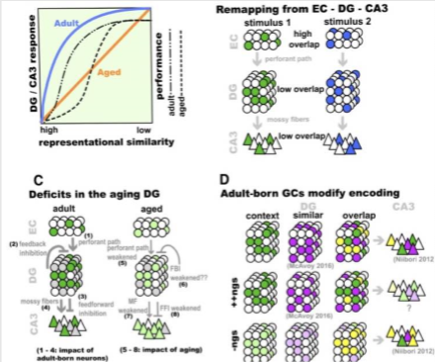
Memory Precision is Impaired With Aging
New M deficits NOT due to sensory, motor, or motivational deficits
Esp. distinguishing from M w/ similar elements
-loss of context data
-interference
- \/response novel stimuli
=> “false recognition”
=> “memory rigidity”
Notes:
1 Dentate gyrus (DG)–CA3 circuitry and pattern separation. (a) Schematic description of DG-CA3 blood oxygen level-dependent responses (left axis, blue and orange lines) and discrimination accuracy (right axis, dashed lines) in adults and aged individuals in a task in which image stimuli were presented and were varied on a continuum from repeat presentation, to similar items or lures, to novel foils (adapted from [14, 26], based on data presented in [23, 24, 72]). Aged individuals showed a failure to activate the DG–CA3 region when similar items or lures were presented. When explicitly tasked with identifying the images as novel or familiar, aged individuals performed more poorly when the images were most similar. (b) The DG performs pattern separation on incoming inputs from the entorhinal cortex (EC). The large number of DGCs relative to the EC (Binput expansion^) and the sparse activation of the DG are thought to facilitate the orthogonalization of similar inputs into distinct outputs. (c) The DG is modified by both incorporation of adult-born DGCs and by aging. 1) Adult-born DGCs may be more responsive to weak perforant path inputs. 2) Adult-born DGCs recruit feedback inhibition (FBI) onto the DG, and (3) feed-forward inhibition (FFI) onto CA3. 4) Adult-born DGCs exhibit increased plasticity at the DG– CA3 synapse. 5) In aged animals, perforant path inputs to DG are weaker, and feedback inhibition (6), and feedforward inhibition (8), may be decreased. 7) CA3 exhibites higher basal activity and hyperexcitability. (d) Adult-born DGCs promote population- based coding in DG and CA3. Enhancing adult hippocampal neurogenesis (ngs) decreases overlap between DG ensembles encoding similar contexts [118]. Decreasing adult hippocampal neurogenesis increases overlap between CA3 ensembles encoding similar contexts [

Slide 30
The DG–CA3 Circuit Supports Pattern Separation and Pattern Completion in Rodents and Humans
DG does Separation [= make similar inputs have different outputs (orthogonalization encoding)]
CA3 does Separation AND Completion [= “M access” w/ limited/impoverished inputs (retrieving complete representations)]
Rate remapping(dif in place cell rates) vs Global remapping (recruitment of nonoverlapping ensembles)
DG-CA3 engaged preferentially during /\interference (repetition-suppression effect[= repeat stimuli causes lower BOLD)
Patient BL: 5x more likely to call “lures” as previously seen => DG in Separation
Calls incomplete rooms as familiar when actually novel => interference fail

Slide 31
Age-Related Changes in DG–CA3 Functions in Rodents
Spatial Memory Task deficits- impairment when bait arm adjacent
Ensemble reactivation sufficient to induce context-specific behavior, this could be failing
Fail to realign place fields to room cues (1) reduced CA3/1 change w/ environment change (2) reduced remapping to new context => rigidity
catFISH: compare ensemble overlap adult/aged, reexposure/novel
-(aged) reexposure : less overlap :: novel : same as adult
- dub Y-maze to novel => similar ensemble reactivation problems

Slide 32
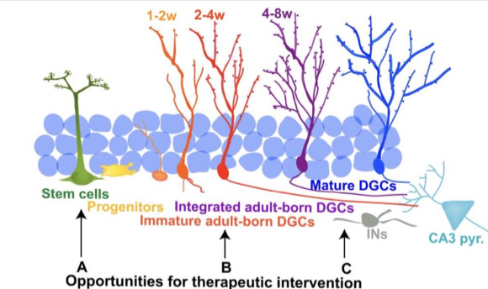
Age-Related Changes in DG–CA3 Functions in Humans
(aged) deficits in DG-CA3 using tasks
-poor discrimination of novel vs familiar
- ID degraded, novel images as familiar
(bias to pattern completion)
-only show similar performance on distinct stimuli presentation (poor discrimination w/ similarity)
-BOLD increases indiscriminately for repeated, novel, and lure stimuli
(aged) require more difference in stimuli vs lures to decrease repetition-suppression effect
Notes:
2 Schematic of adult hippocampal neurogenesis and opportunities for intervention. Adult-born dentate granule cells (DGCs) arise from neural stem cells in the subgranule zone of the DG, with activated neural stem cells giving rise to transiently active progenitors, which differentiate into immature DGCs. Immature DGCs form afferent and efferent connections in a stereotyped order, and the acquisition of these inputs (initially γ-aminobutyric acid, and then glutamatergic inputs from the entorhinal cortex) governs their survival and integration into the hippocampus. Opportunities for therapeutic intervention to increase the adult-born DGC population or to mimic their effects on the circuit are highlighted: (a) removal of age-related molecular breaks on stem-cell activation and proliferation; (b) promoting integration of adult-born DGCs; (c) modulating DGC connectivity to increase feed-forward and feedback inhibition. IN Interneuron

Slide 33
Age-Related Changes in DG–CA3 Structure and Connectivity
Global HC size loss correlates with explicit memory, esp. DG
EC input (less synapse #, lower amplitude APs) to DG: LTP harder to induce, persist
Cxn losses correlated w/ representational rigidity and poor discrimination
CA3 hyperexcitable (reduced feedforward inhibition DG-CA3, impaired plasticity)
# DG-CA3 inhibitory interneurons reduced w/ age

Slide 34
Neurogenesis Decreases With Aging and Adult-Born DGCs Contribute to Pattern Separation
“Adult neurogenesis exquisitely sensitive to circuit demands, w/ tight regulation by discrete, yet overlapping mechanisms at multiple stages...”
Active NSC -> transient neural progenitors -(differentiate)-> immature DGCs
Immature DGCs - input in stereotyped order, gov’n survival and integration
@4-8 weeks, heightened plasticity, H(high contribution to memory processing), and are sufficient for discrimination when mature DGs genetically silenced
^population: improves MWM performance on target reversal, not acquisition
*DG neurogenesis declines rapidly in rodents, unlike humans
M retrieval requires adult-born DGCs, optogenetic silencing

Slide 35
Circuit Mechanisms Underlying the Functions of Adult-Born DGCs in Memory Encoding
Adult-Born DGCs Exert Feedback Inhibition Onto the DG to Promote Sparseness
Gamma oscillation synchrony increase with neurogenesis ablation
Increased neurogenesis decreases DG activity and increases DG threshold, 6 > 4 wk old
Sparseness from neural competition and redistribution of EC-DG synapses, Bax gene
Sparseness modulated in “mismatch manner”
Ablation decreased sparse only under high interference conditions (reversal learning)
Using cfos w/ catFISH shows increasing -genesis decreased ensemble overlap in similar, but not distinct contexts
Mismatch-dependent suppression of DG activity with ^genesis

Slide 36
Circuit Mechanisms Underlying the Functions of Adult-Born DGCs in Memory Encoding
Adult-Born DGCs May Modulate Feed-Forward Inhibition in DG–CA3 Circuit
*”remains poorly understood”
Mossy fiber --< CA3 interneurons, plasticity correlates with memory precision
4-6wk adult-born DGC have increased synaptic cxn, decreases with further maturity
Manipulate adult -genesis during M retrieval
-irradiation/stressor: drops ensemble reactivation overlap in CA3 on reexposure, (retrieval failure)
-pharma/genetic reduction: increased overlap to similar, but not different contexts
-enhancing: increases strength of long term M

Slide 37
Targeting Adult Neurogenesis to Improve DG–CA3 Functions in Aging
Promoting Integration of Adult-Born DGCs Into the Hippocampal Circuit
Mature DGCs activity mods survival of 1-2 wk via hilar parvalbumin Interneurons
2-4 wk olds compete w/ mature DGCs for EC glu synapses, if bias toward mature
-Klf9 ((-)reg of spines) ^survival
-Rac1 (cytoskele factor) deletion: mimics Klf9 response?
Enhanced adult DGCs enhances discrimination of similar contexts 1 day vs 2 wks

Slide 38
Targeting Adult Neurogenesis to Improve DG–CA3 Functions in Aging
Removing the Brakes on Neural Stem Cell Activation
Factors causing -genesis decline throughout life are unknown
Let’s hypothesize:
Young blood works, heterochronic parabiosis
Cutting molecular brakes seems to work, but intricate
Microglia activation, corticosteroid secretion might (-)reg, still incomplete story

Slide 39
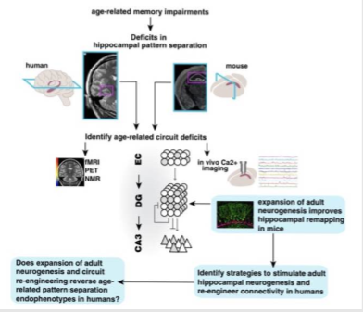
Towards Healthy Cognitive Aging in the Future
EC DBS promotes M in small, not large study
Metformin and NMDA ant. Memantine both show Alzheimer’s efficacy
Molecular basis of exercise benefits on cognition still unknown
Overexpression alone doesn’t imply improved M performance
Need behavioral, circuit, and cellular level analysis
Notes:
3 Schema for how rodent studies edify novel therapeutic neurogenesis-based strategies to optimize dentate gyrus (DG)–CA3 circuit functions and improve memory in aged humans. Deficits in pattern separation/completion balance in DG–CA3 are observed/ inferred in both rodents and humans, albeit at different levels of imaging resolution. Rodent studies permit elucidation of circuit-based mechanisms by which neurogenesis modulates DG–CA3 functions. Identification of circuit-based mechanisms facilitates development of strategies that target these mechanisms to promote DG–CA3 functions. Development of novel imaging approaches to visualize adult hippocampal neurogenesis or capture pattern separation at higher resolution will permit evaluation of efficacy of new therapeutic strategies. fMRI = functional magnetic resonance imaging; PET = positron emission tomography; NMR = nuclear magnetic resonance; EC = entorhinal cortex

Slide 40
+Zen time
Background Paper B: Conclusions, Discussion, and Topic Paper Hypotheses...

Slide 41
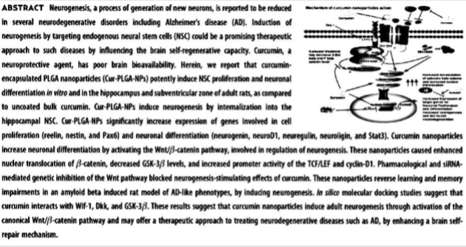
Curcumin-Loaded Nanoparticles Potently Induce Adult Neurogenesis and Reverse Cognitive Deficits in Alzheimer's Disease Model via Canonical Wnt/β-Catenin Pathway
BETTER IMAGE LATER

Slide 42
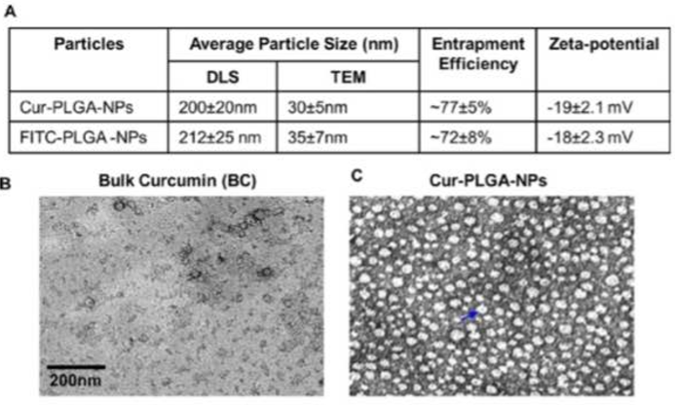
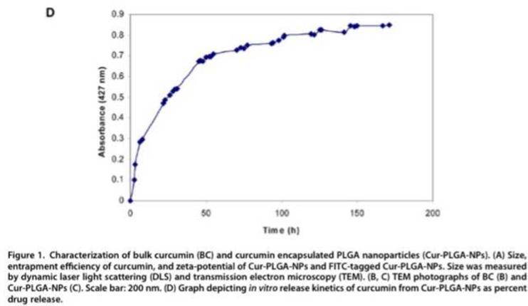
Fig1 Characterization of Curcumin
DLS (hydrodynamic diameter) vs TEM (morphology)
Entrapment efficiency
Zeta-potential
Release kinetics in ½ ethanol
-linear for first 60%, 74% released/wk
Notes:
Figure 1. Characterization of bulk curcumin (BC) and curcumin encapsulated PLGA nanoparticles (Cur-PLGA-NPs). (A) Size, entrapment efficiency of curcumin, and zeta-potential of Cur-PLGA-NPs and FITC-tagged Cur-PLGA-NPs. Size was measured by dynamic laser light scattering (DLS) and transmission electron microscopy (TEM). (B, C) TEM photographs of BC (B) and Cur-PLGA-NPs (C). Scale bar: 200 nm. (D) Graph depicting in vitro release kinetics of curcumin from Cur-PLGA-NPs as percent drug release.

Slide 43
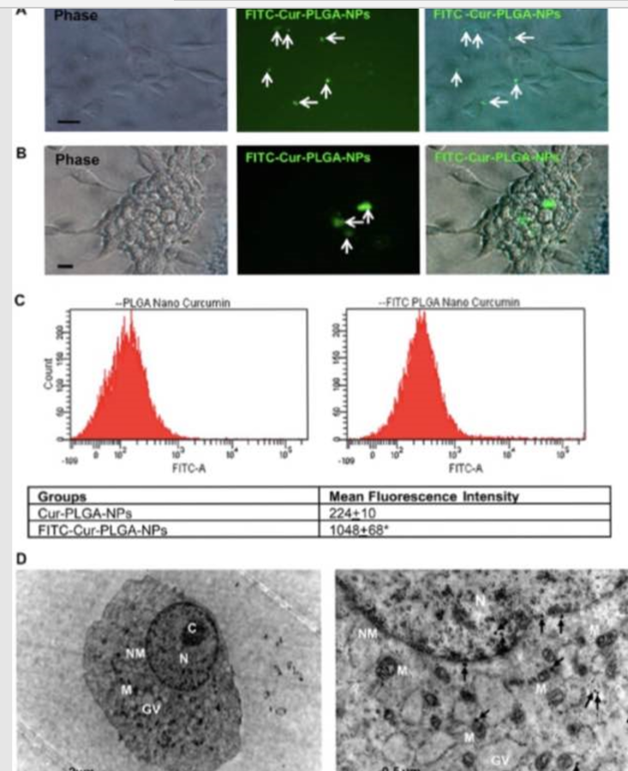
Fig2 Cur-NPs Cellular Uptake
NSCs,
Neurospheres,
Flow cytometry analysis
TEM show cytoplasmic and nuclear uptake
Notes:
Figure 2. Cellular uptake of Cur-PLGA-NPs and FITC-Cur-PLGA-NPs. (A, B) Phase contrast and fluorescent images of the hippocampus-derived neural stem cells (NSC) (A) and neurospheres (B) after exposure to FITC-Cur-PLGA-NPs. Twenty-four hours post-treatment, FITC-Cur-PLGA-NPs were observed in the cytoplasm of the cells. Images are both at phase contrast and FITC channel. (Scale bar = 20 μm.) (C) Flow cytometry analysis in the FITC channel showing uptake of Cur-PLGA-NPs and FITCPLGA-NPs in NSC by a shift in FITC mean fluorescence intensity (n = 3), *p < 0.05. (D) TEM photographs showing uptake of CurPLGA-NPs in the cytoplasm as well as their internalization in the nucleus of NSC. C = chromatin, N = nucleus, NM = nuclear membrane, M = mitochondria, GV = Golgi vesicles. Scale bars are 2 and 0.5 μm.

Slide 44
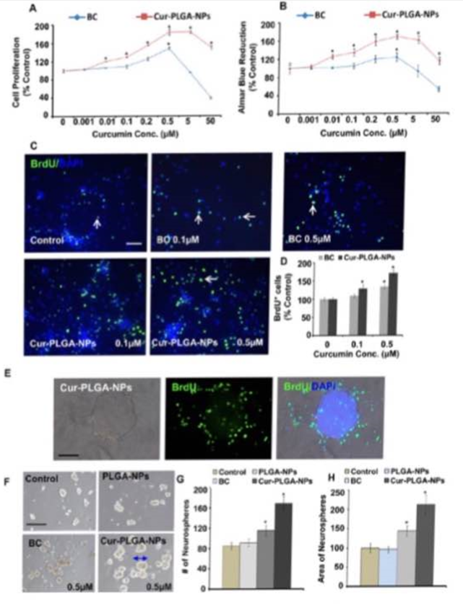
Fig3 NPs ^NSC proliferation
A, B) HC-derived NSC in well plates
C) BrdU rxn in NSC culture
D) BrdU rxn quant
E) BrdU rxn in neurospheres
F) phase-contrast of neurospheres (NSC/HC)
G, H) # and area of neurospheres
Notes:
Figure 3. Cur-PLGA-NPs stimulate proliferation of the hippocampus-derived NSC and increase the number of primary neurospheres. (A, B) NSC derived from the hippocampus were seeded into 96-well culture plates and treated with the indicated concentrations of both bulk curcumin (BC) and Cur-PLGA-NPs for 24 h. The MTT assay and alamar blue assay were performed for cell proliferation analysis. Values are expressed as mean ( SEM (n = 3). *p < 0.05 versus BC. (CE) BrdU immunoreactivity in NSC cultures (C) and neurospheres (E). BrdU immunoreactive cell quantification in the NSC cultures treated with curcumin (D). Graphical representation of percent increase of BrdUþ cells labeled with the nuclear stain DAPI compared with the corresponding value for control as well as BC. Values are expressed as mean ( SEM (n = 3). *p < 0.05 versus control. Scale bar = 20 μm. (F) Representative phase-contrast photomicrographs of primary neurospheres derived from the hippocampus NSC treated with 0.5 μM each of BC, PLGA-NPs, and Cur-PLGA-NPs. (G, H) Quantification of the number of neurospheres (G) and area of neurospheres (H). Cur-PLGA-NP treatment caused a significant increase in the number and size of primary neurospheres as compared to control. Values are expressed as mean ( SEM (n = 3). *p < 0.05 versus control.

Slide 45
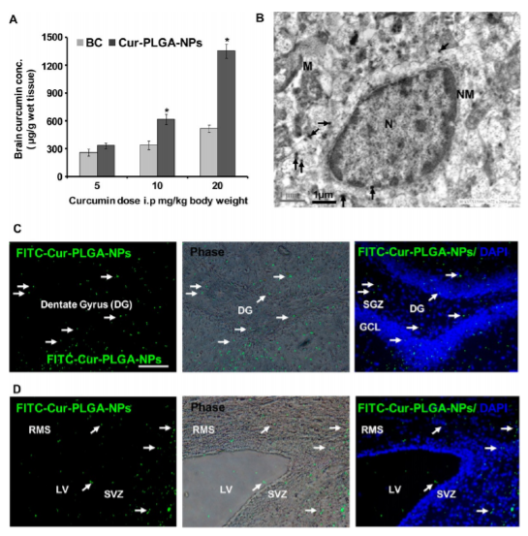
Fig4 Cur-NPs organism bioavailability
HPLC quant of BC vs Cur-PLGA-NP in brain
TEM shows NP in cytoplasm, nucleus
(&D) FITC-Cur-PLGA-NPs w/ colocalized DAPI (nuclear stain)
Notes:
Figure 4. Cur-PLGA-NPs and FITC-Cur-PLGA-NPs internalize into the brain and enhance curcumin bioavailability. (A) Rats were treated with BC and Cur-PLGA-NPs (5, 10, 20 mg/kg body weight, ip). Levels of curcumin in the brain were measured by HPLC. Levels of curcumin were higher in the brain of rats treated with Cur-PLGA-NPs as compared to BC. Values are expressed as mean ( SEM (n = 6 rats/group). *p < 0.05 versus BC. (B) TEM photomicrograph of the hippocampus region showing accumulation of Cur-PLGA-NPs in the cytoplasm and internalization in the nucleus. N = nucleus, NM = nuclear membrane, M = mitochondria. Scale bar = 1 μm. (C, D) Fluorescence images at the FITC channel depict the uptake of FITC-Cur-PLGA-NPs in the hippocampus and the SVZ region of the rat brain and their co-localization with the nuclear stain DAPI. DG = dentate gyrus, SGZ = subgranular zone, GCL = granular cell layer, RMS = rostral migratory stream, LV = lateral ventricle. Scale bar = 100 μm.

Slide 46
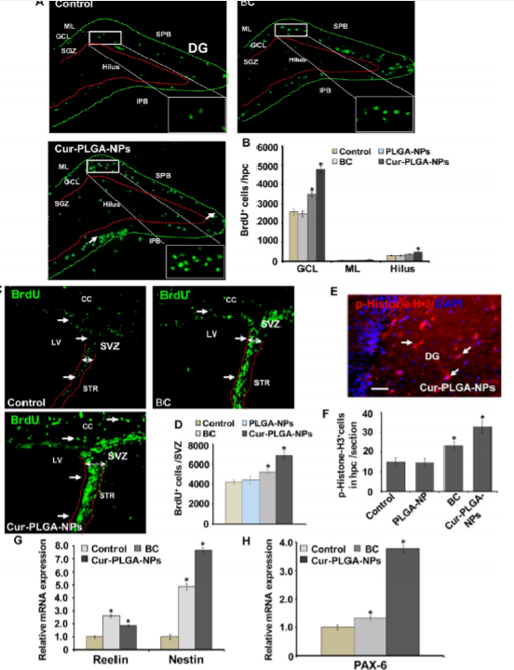
Fig5 NPs on NSC proliferation/renewal
BrdUb in DG, esp. Hlas and granular cell layer, few in molecular layer
Quant of BrdUb in hilus, GCL, and ML
BrdUb in SVZ (ctrl, BC-, NP+); NPs=> ^# BrdUb, SVZ thickening
Quant of BrdUb in SVZ
(&F) NPs ^phospho-histone-H3b granule neuroblasts in HC and SVZ
G, H) Quant real-time PCR for relative mRNA
-nestin- marker of NSC
-reelin- ECM protein for migration & differentiation of NSC
-Pax6- ?
Notes:
Figure 5. Cur-PLGA-NPs induce proliferation and self-renewal of NSC in the hippocampus and SVZ of adult rats. (A) Photomicrographs showing immunostaining of BrdUþ cells in the dentate gyrus region of the hippocampus. BrdUþ cells were mostly evident in the hilus and granular cell layer (GCL) regions, while a few BrdUþ cells were also present in the molecular layer (ML) of the dentate gyrus in all the groups. Arrows indicate BrdUþ cells. Inset shows typical morphology of darkly stained, irregular shaped, and compact BrdUþ nuclei. SPB = suprapyramidal blade, IPB = infrapyramidal blade. Scale bar = 100 μm, 10 μm in inset. (B) Bar diagram showing quantitative analysis of the number of BrdUþ cells in the GCL, hilus, and ML of the hippocampus. Values are expressed as mean ( SEM (n = 6 rats/group). *p < 0.05 versus BC. (C) BrdUþ cells in the SVZ of control, BC-, and Cur-PLGA-NP-treated rats. Cur-PLGA-NP treatment caused an increased number of BrdUþ cells and thickening of the SVZ lining containing NSC. (D) Quantification of BrdUþ cells in the SVZ. Values are expressed as mean ( SEM (n = 6 rats/group). *p < 0.05 versus control. (E, F) Treatment of Cur-PLGA-NPs increases the number of phospho-histone-H3þ granule neuroblasts in the hippocampus and SVZ. For analysis of proliferating cells, coronal sections from control, BC-, and Cur-PLGA-NP-treated rats were co-labeled with mitosis-specific marker phospho-histone-H3 and nuclear stain DAPI. (F) Quantitative analysis of hippocampal sections suggested a significant increase of phospho-histone-H3þ mitotic cells in Cur-PLGA-NP-treated rats than control and BC. (G, H) Quantitative real-time PCR analysis was performed for relative mRNA expression of nestin (marker of NSC), reelin (an extracellular matrix protein required for proper migration and differentiation of NSC), and Pax6 in the hippocampus and normalized to β-actin. Values are expressed as mean ( SEM (n = 6 rats/group). *p < 0.05 versus control.

Slide 47
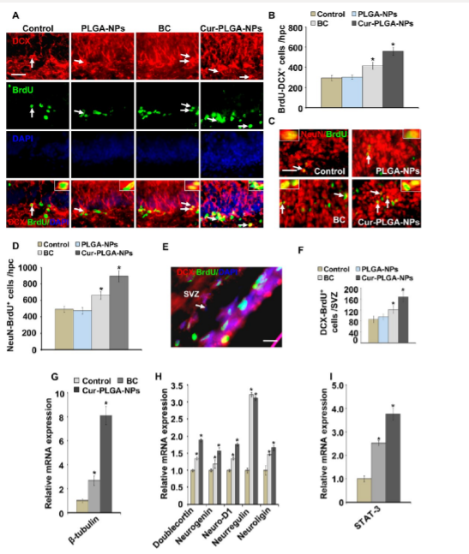
Fig 6 Immunostaining Proliferation and Differentiation
DCX (immature neuron marker) colabeled w/ BrdU (proliferation marker) [Arrows= colabel]
Quant of (A)
NeuN (reed: mature neuron marker) w/ BrdU (green: ) in DG
Quant of C), dropped # mature colabel w/ Cur-NPs
Photomicrograph, ^DCX/BrdU colabel in SVZ
Quant of E)
G-I) qRT-PCR suggesting ^relative mRNA of neurogenic genes and the TF Stat3 in HC of Cur-NP treated rats
Notes:
Figure 6. Cur-PLGA-NPs increase neuronal differentiation and adult neurogenesis in the hippocampus and SVZ of rats. (A) Double immunofluorescence analysis of newly born neurons co-labeled with DCX (red: marker for immature neurons) and BrdU (green; proliferating marker) in the dentate gyrus region of the hippocampus of PLGA-NP-, bulk-curcumin (BC)-, and Cur-PLGA-NP-treated rats. Arrows indicate BrdUþ nuclei co-labeled with DCX. Inset showing higher magnification of BrdU/DCX co-labeled cells. Scale bar = 100 μm, and 10 μm in inset. (B) Quantitative analysis in the hippocampal sections showed a significantly increased number of immature neurons co-labeled with BrdU/DCX, suggesting increased neuronal differentiation in Cur-PLGA-NP-treated rats. Values are expressed as mean ( SEM (n = 6 rats/group). *p < 0.05 versus control. (C, D) Cells were double labeled with BrdU (green) and NeuN (red; mature neuronal marker) in the dentate gyrus region of the hippocampus. Arrows indicate BrdUþ nuclei co-labeled with NeuN. (D) Quantification analysis suggested a significantly decreased number of mature neurons co-labeled with BrdU/NeuN in the hippocampus of Cur-PLGA-NP-treated rats. (E, F) Photomicrograph and quantitative analysis show a significantly increased number of DCX/BrdU co-labeled cells in the SVZ of Cur-PLGA-NP-treated rats. (GI) Quantitative analysis by qRT-PCR suggested significantly increased relative mRNA expression of neurogenic genes and transcription factor Stat3 in the hippocampus of Cur-PLGA-NP-treated rats.

Slide 48
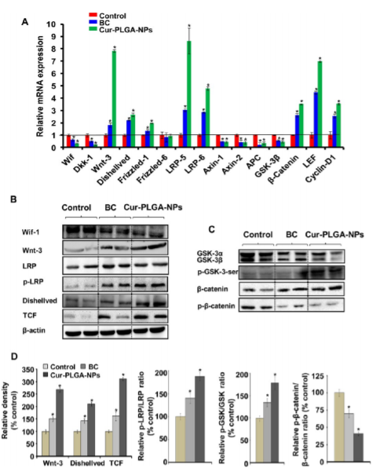
Fig7 NPs ^-genesis via Wnt/b-catenin
qRT-PCR for Wnt/beta-catenin pathway mRNA expression
(& C) Westerns of Wif-1, Wnt3a, (p-)LRP, dishevelled, TCF, (p-) GSK-3beta, (p-)beta-catenin
D) ratios of phosphorylated LRP and GSK-3b increased, p-beta-catenin decreased in NP treated rats
Notes:
Figure 7. Cur-PLGA-NPs increase neurogenesis in the hippocampus through activation of the Wnt/β-catenin pathway. (A) Quantitative real-time PCR analysis was performed for relative mRNA expression of genes of the Wnt/β-catenin pathway in control, bulk curcumin (BC)-, and Cur-PLGA-NP-treated rats. β-Actin served as housekeeping gene for normalization. Values are expressed as mean ( SEM (n = 6 rats/group). *p < 0.05 versus control. (B, C) Western blot analysis of Wif-1, Wnt3a, LRP, p-LRP, dishevelled, TCF, GSK-3β, p-GSK-3β, β-catenin, and p-β-catenin protein levels in the hippocampus. Values were normalized to β-actin, used as a loading control. (D) Quantification of relative protein density after normalization with β-actin. Ratio of p-LRP/LRP, p-GSK-3β/GSK-3β was significantly increased and p-β-catenin/β-catenin significantly decreased in CurPLGA-NP-treated rats. Representative blots showing two samples from each group. Mean ( SEM (n = 6 rats/group). *p < 0.05 versus control.

Slide 49
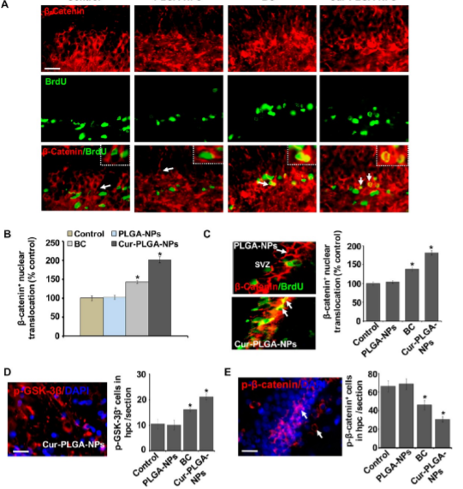
Fig8 NPs ^pathway by (1) nuclear localization of b-catenin
(2) phosphorylation of GSK-3b
Immunostains show cyto- and nuclear localization of b-catenin, colocalized w/ BrdU
Quant shows ^b-catenin nuclear translocation in HC
“ “ in SVZ
Quant of p-GSK3b (red) and (E) p-b-catenin (red) + cells w/ DAPI (blue)
suggest up-regulation of GSK-3b phos, down-regulation of b-catenin phos by these NPs
Notes:
Figure 8. Cur-PLGA-NPs activate the Wnt/β-catenin pathway via enhancing nuclear localization of β-catenin and phosphorylation of GSK-3β in the hippocampus. (A) Immunofluorescence photomicrographs show cytoplasmic and nuclear localization of β-catenin (red), a key regulatory protein of the Wnt pathway, and its co-localization with BrdU (green) in the hippocampus of control, bulk curcumin (BC)-, PLGA-NP-, and Cur-PLGA-NP-treated rats. Arrows indicate BrdUþ nuclei colabeled with β-catenin. Inset shows higher magnification of BrdU/β-catenin co-labeled cells and nuclear localization of β-catenin. Scale bar = 100 μm, and 10 μm in inset. (B, C) Quantitative analysis shows that Cur-PLGA-NPs significantly enhance the percent nuclear translocation of β-catenin in the hippocampus (B) and SVZ (C). Values are expressed as mean ( SEM (n = 6 rats per group). *p < 0.05 versus control. (D, E) Quantification of p-GSK-3β (red) and p-β-catenin (red) positive cells with DAPI (blue) suggests a significant up-regulation of GSK-3β phosphorylation, and down-regulation of β-catenin phosphorylation by Cur-PLGA-NPs in the hippocampus.

Slide 50
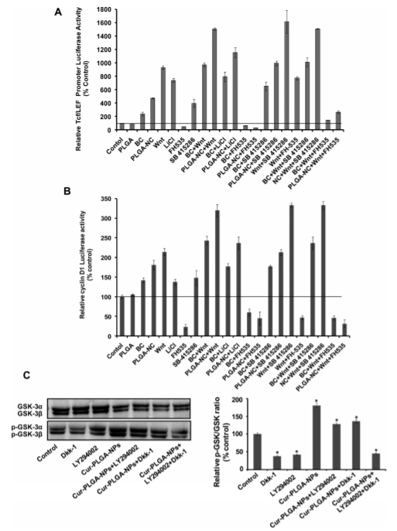
Fig9 NPs enhance cyclin-D1 & TCF/LEF promotors, inhibit GSK-3b thru this pathway
(A, B) NSC/HC transfected w/ cyclin-D1 promotor linked to luciferase reporter in pGL3 vector and TCF/LEF promoter
Given various inhibitors:
FH535 ((-)b-catenin/TCF)
SB-41286 & LiCl ((-) GSK3-b)
\C) NSC cultures given inhibitors, (p-)GSK-3bR quntified
Dkk-1 ((-) Wnt pathway)
Ly294002 ((-)PI3K/Akt)
Notes:
Figure 9. Cur-PLGA-NPs enhance cyclin-D1 and TCF/LEF promoter activity and inhibit GSK-3β in NSC via activation of the Wnt/ β-catenin pathway. (A, B) The hippocampus-derived NSC were transfected with a cyclin-D1 promoter (1.88kb) construct linked to a luciferase reporter gene in the pGL3 vector and TCF/LEF promoter. NSC were treated with the β-catenin/TCF inhibitor FH535, GSK3-β inhibitors SB-415286 and LiCl, and Wnt3a protein in the presence and absence of bulk curcumin (BC) and Cur-PLGA-NPs. The luciferase activity is normalized to the firefly luminescence over renilla luminescence. Cur-PLGA-NPs significantly increased cyclin-D1 and TCF/LEF promoter activity in NSC. Values represent mean ( SEM of three experiments. (C) NSC cultures were treated with Wnt pathway inhibitor Dkk-1 and PI3K/Akt inhibitor LY294002 in the presence and absence of Cur-PLGA-NPs and bulk curcumin. After respective treatments, protein levels of GSK-3R/β and p-GSK-3R/β were studied. Values are expressed as mean ( SEM (n = 4). *p < 0.05 versus control.

Slide 51
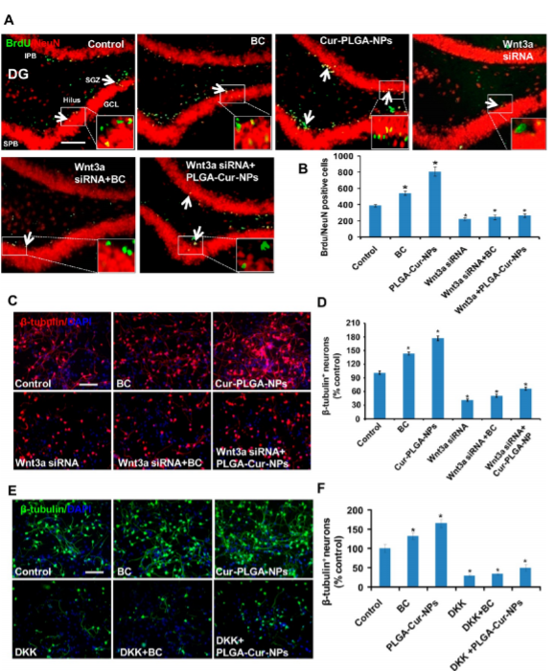
Fig10 Genetic and Pharma- inhibition of Wnt path drops Cur-NP effect in HC and culture
A, B) Wnt3a KO by stereotaxic injection drops BrdU/NeuN positives in BC and Cur-NPs
C, D) NSC cultures transfected w/ Wnt3 siRNA
E, F) NSC cultures w/ Wnt pathwat and PI3K/Akt inhibitors
Dkk-1 abolishes curcumin differentiation effect
Notes:
Figure 10. Pharmacological and genetic inhibition of the Wnt pathway reduces Cur-PLGA-NP-mediated stimulatory effects on neuronal differentiation in the hippocampus and NSC cultures. (A, B) Wnt3a knockdown was done by the stereotaxic injection of Wnt3a siRNA and scrambled sequences directly into the hippocampus of control, BC-, and Cur-PLGA-NP-treated rats. Wnt3 knockdown significantly reduced the number of BrdU/NeuN-positive neurons in the BC and Cur-PLGA-NPs groups. (C, D) NSC cultures were transiently transfected with Wnt3 siRNA. Mean þ SEM of three independent experiments. *p < 0.05 versus control. Scale bar = 100 μm. (E, F) NSC cultures were treated with Wnt pathway inhibitor Dkk-1 and PI3K/Akt inhibitor LY294002 in the presence and absence of Cur-PLGA-NPs and bulk curcumin. Dkk-1 protein abolished neuronal differentiation enhancing potential of curcumin in the hippocampal-derived NSC culture. Values are expressed as mean ( SEM (n = 4). *p < 0.05 versus control

Slide 52
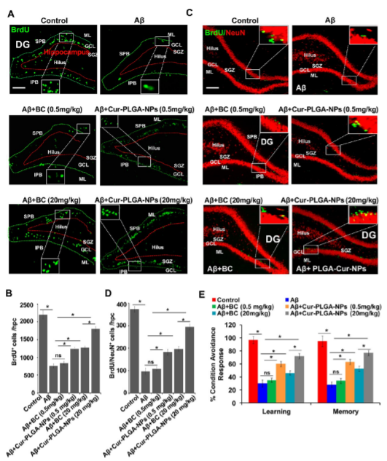
Fig11 Cur-NPs protect from Abeta-induced degeneration, reverse learning and memory deficits
A,) immunostaining BrdUb in DG w/ stereotaxic Abeta injection, followed by Cur-PLGA-NPs after one week
B) Quant of b-tubulin/BrdU colabeled
Suggests enhanced differentiation despite Abeta
C) mature neurons w/ -tubulin (red: maturity marker) and BrdU (green) in DG
D) BrdUb cell quant in HC
E) Cognition: 2way conditioned avoidance,
Cur-PLGA-NPs reverses deficits
Notes:
Figure 11. Cur-PLGA-NPs provide neuroprotection against Aβ-induced neurodegeneration and reverses learning and memory deficits. (A, B) Photomicrographs showing immunostaining of BrdUþ cells in the dentate gyrus region of the hippocampus. Rats were given a single stereotaxic injection of Aβ in the hippocampus. After one week of Aβ injection, rats were treated with 0.5 and 20 mg/kg body weight BC and Cur-PLGA-NPs. DG = dentate gyrus, SGZ = subgranular zone, GCL = granular cell layer, ML = molecular layer. (D) Quantification of BrdUþ cells in the hippocampus. Values are expressed as mean ( SEM (n = 6 rats/group), ns = nonsignificant. *p < 0.05. (C, D) Double immunofluorescence analysis of matured neurons colabeled with β-tubulin (red: marker for mature neurons) and BrdU (green) in the dentate gyrus region of the hippocampus Scale bar = 20 μm. (B) The quantitative analysis of β-tubulin/BrdU co-labeled cells suggests that Cur-PLGA-NPs significantly enhanced the neuronal differentiation in the Cur-PLGA-NPs þ Aβ group, which was inhibited by Aβ. Values are expressed as mean ( SEM (n = 3). *p < 0.05. (E) The cognitive ability (learning and memory) of the control and Aβ-, BC-, and Cur-PLGA-NPsþ Aβ-treated rats was measured following assessment of two-way conditioned avoidance behavior. Cur-PLGA-NPs significantly reversed the Aβ-induced deficits in learning and memory as compared to control rats. Values are expressed as mean ( SEM (n = 6 rats/group). *p < 0.05.

Slide 53
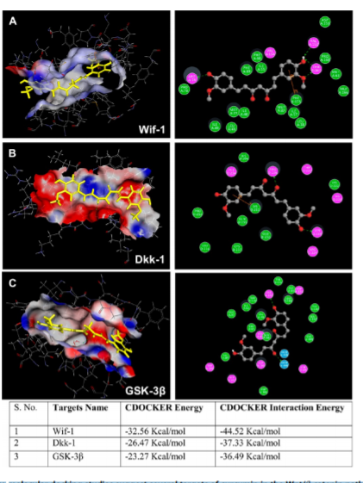
Fig12 In silico docking of Curcumin in Wnt/beta-catenin Path
Yellow Curcumin in binding cavities colored by H- and pi- bond characterization,
-receptor donor= pink
-receptor acceptor= green
Wif-1
Dkk-1
GSK-3beta
Notes:
Figure 12. In silico molecular docking studies suggest several targets of curcumin in the Wnt/β-catenin pathway: Surface is generated around the curcumin (yellow color) in the binding cavity and colored by hydrogen bond character, with receptor donor colored in pink and receptor acceptor in green. A 2D depiction of curcumin and the binding site residues of (A) Wif-1, (B) Dkk-1, and (C) GSK-3β. Hydrogen bonds and pi interaction between the surrounding amino acid residues and the ligand are also displayed. Curcumin molecule is depicted in yellow color.

Slide 54
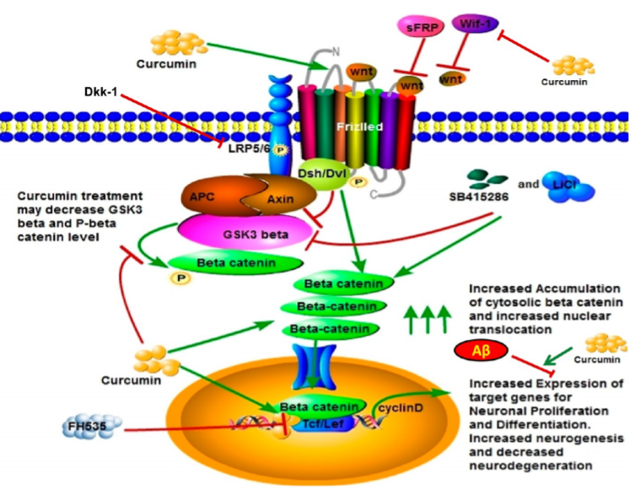
Fig13
Notes:
Figure 13. Proposed schematic model for the role of curcumin in neurogenesis through activation of the Wnt/β-catenin signaling pathway: On the basis of experimental and in silico studies we found that curcumin may increase Wnt levels by interacting with Wnt inhibitory molecules such as Wif-1 and Dkk-1, thus activating the Wnt pathway. Wnt interacts with the 7-transmembrane Frizzled receptor and phosphorylated co-receptor low-density lipoprotein (LRP-5/6), which triggers activation of cytoplasmic dishevelled (Dvl) protein. Activated Dvl then interacts with destruction complex Axin/APC/GSK3β and inhibits GSK-3β, which phosphorylates β-catenin and promotes β-catenin degradation through proteasomal degradation in the absence of Wnt. Inhibition of GSK-3β leads to accumulation of cytoplasmic β-catenin and its translocation into the nucleus. In the nucleus β-catenin interacts with the TCF/LEF promoter complex, leading to activation of target genes that are involved in proliferation and differentiation of NSC. After cellular internalization curcumin may likely interact with GSK-3β, thus enhancing the levels of cytoplasmic β-catenin, and decrease its phosphorylation. Curcumin then enhances β-catenin nuclear translocation, leading to enhanced TCF/LEF and cyclin-D1 promoter activity and increased neurogenesis. The blockage of the Wnt/β-catenin signaling through Wnt siRNA, Dkk-1, and TCF inhibitor FH535 leads to inhibition of curcumin-mediated cell proliferation and neuronal differentiation. Curcumin also blocks Aβ-mediated inhibitory effects on neurogenesis through induction of the Wnt/β-catenin signaling.

Slide 55
Topic Paper Conclusions and Final Discussion
Mathematical analysis helps isolate the behavior of (abstract, perhaps multidimensional) variables to better articulate hypotheses for otherwise unassailable biological processes, as well as permit information-transfer optimization juxtapositions between Nature and Theory.
Adult hippocampal neurogenesis is an integral component in the computational transformations required for memory encoding and retrieval
Performance on behavioral tasks requiring these computations decreases with the aging phenotype and the site performing them is highly sensitive to neurodegeneration
Nanoparticle delivery of the antioxidant, curcumin, seems to promote neurogenesis, provide neurodegenerative protection, and improve performances on behavioral task requiring the EC-DG-CA3 circuitry through the Wnt/beta-catenin pathway

